Slide 1
REDUCE NUNR FS PUMPS FROM 4 TO 3 BY DECOMMISSIONING EXPORT PUMP 3 FOR COST OPTIMIZATION
Business Case:
The Nun River Flow station is currently using four pumps, EP1, EP2, EP3 and EP4 for delivery of its production to the TNP. The pumps are of Sulzer centrifugal pumps and is driven by a G3412 CAT engines. Given the production profile of the station which averages at 12kbbls daily production, a single pump is sufficient for steady state production. However, at periods of high Trunk line pressures, use of two pumps may become necessary to overcome pressures in excess of 30barg which occurs when the TNP is downgraded from 28” to 24”.
Most recently, the station experienced pump reliability challenges given erratic failure frequencies occasioned by escalating costs and maintenance pressures. This necessitated a comprehensive pump rationalization programmed conducted in-house to improve the pump efficiencies and eliminates wastes. A decision was reached to streamline to use of three pumps and decommission EP3 which indicated the least efficiency.
Objective: To align with central Hub’s commitment to prudence, cost reduction, goal zero and resource efficiencies.
Potentials Benefits and Measurements.
Cumulative Cost savings (10yrs) of +/- $303k.
Improve focused delivery and reliability
Eliminate wastes
Aligns with industry best sparing practices.
High Level Timeline
L1:31.07.19
L2: 31.07.19
L3: 18.08.19
L4: 25.08.19
L5: 26.08.19
Projects and Actions
L1: 31.05.19: Determine Scope/Business case.
L2: 15.06.19: Complete cost benefit analysis
L3: 18.06.19 : Obtain leadership approval for implementation
L4: 25.06.19: Implement decision
L5: 26.06.19: Complete decommission and monitor savings
Key task:
Source for discharge blind flanges 4’’X600 and 2’’X600 - 31.07.2019
Carry out suction and discharge valve isolation. -12.07.2019
Carry out tagging of valves - 17.07.2019
Critical Success Factors
Timely Approval.
CBA quality.
Onsite supports
Project Sponsor
NuN River PUM.

Slide 2
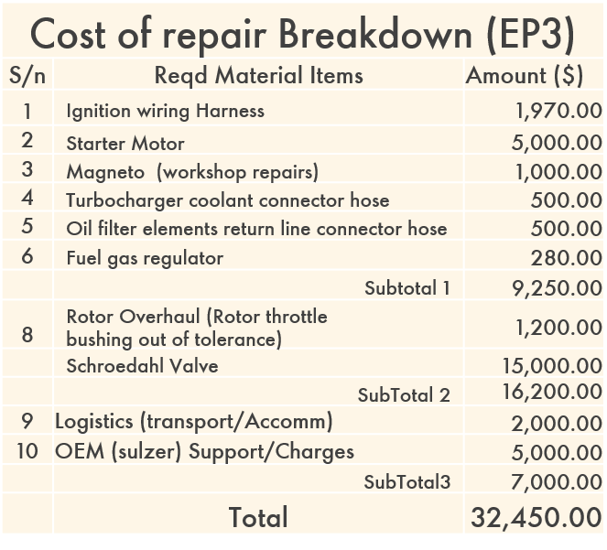
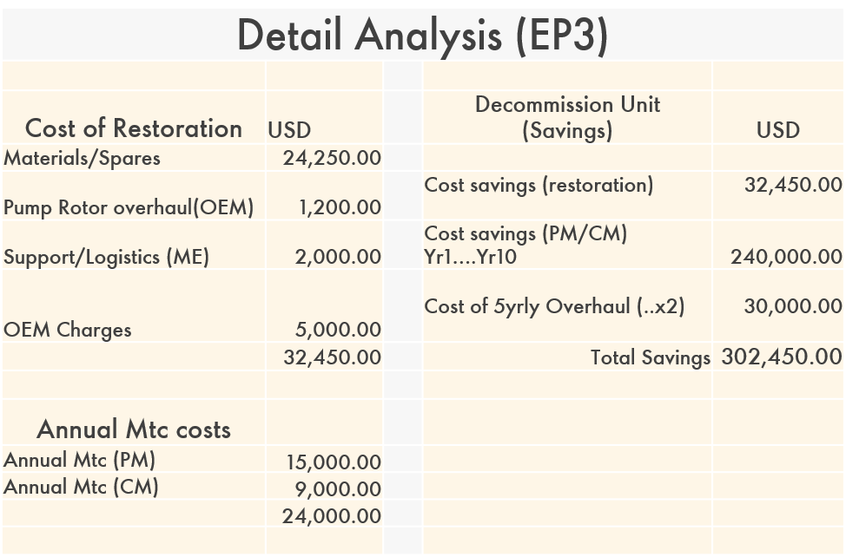
Analysis

